Slide 1
DO NOW – 10 min
Read the first section in the Junior Scholastic on pg. 10.
As you read, underline the main idea of each paragraph.
STOP when you get to A Warm Welcome, Then A Backlash
Write a summary for the introduction.

Slide 2
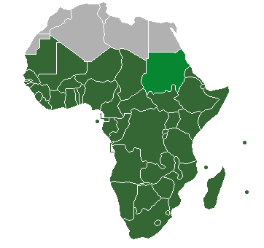
Do Now (5 min) 10/21-24 Sub-Saharan Africa Geography pg. 37-38
Choose ONE color that is different from the first color you used for SW Asia/North Africa.
Color the countries that are green on your world map at the back of your notebook.
Add the region to your legend.

Slide 3
Engage: What if…?(10 min)
List 5 or more things you typically do every week.
(3 min)
Notes:
Look at the first section of the What If? handout. In the space provided, list 5 or more things you typically do every week. You might include daily routines, such as walking or riding the bus to school, playing sports after school, or visiting the nearest grocery store to buy a snack. You will have 3 minutes to complete this task.

Slide 4
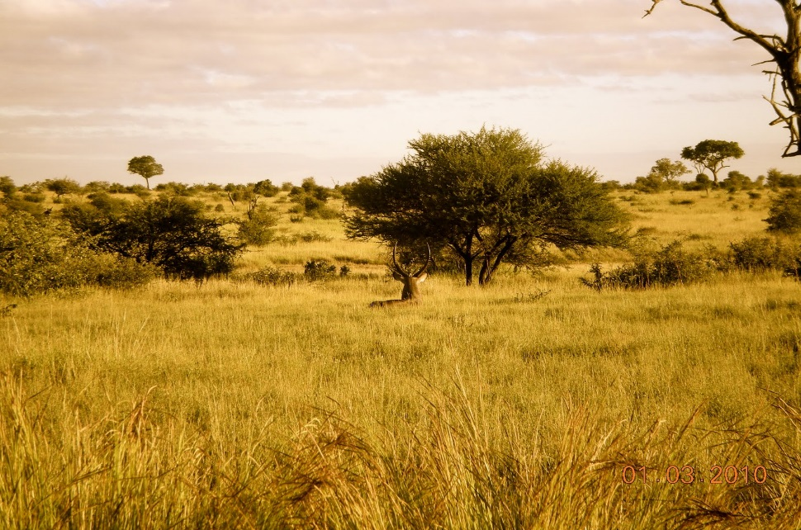
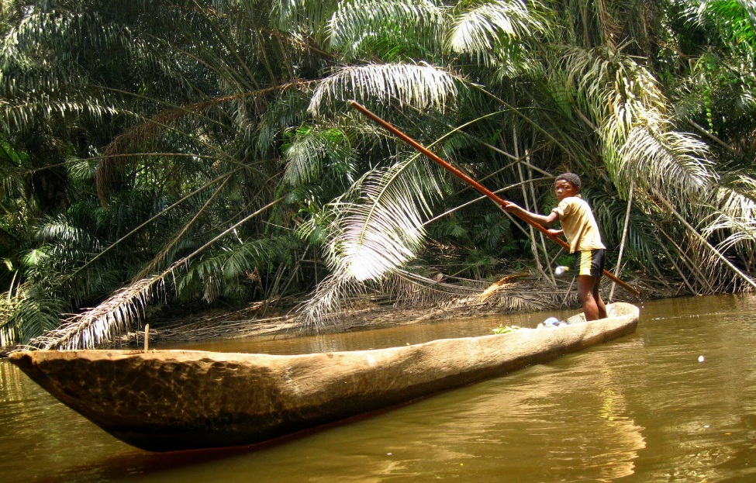
Carefully examine the images below. For each image, write down two ways your routines and activities might be different if you lived in the environment shown. (3 min)
Notes:
carefully examine the images projected on the board. You will find the same images
in the second section of the What If? handout. For each image, write down two ways your routines and activities might be different if you lived in the environments shown.
The images that you have just examined were taken in different parts of Africa—
particularly, in areas south of the Sahara Desert. The first image was taken in Kruger National Park in South Africa and the second in Congo River Basin Rainforest. As you can see from viewing the photos, Sub-Saharan Africa is diverse in terms of its physical features and people living within the region must adapt to their surroundings. Today, we will learn about how geographic factors/features affect settlement patterns and population distribution in a region.

Slide 5
Objectives
6.3A Pose and answer geographic questions, including: Where is it located? Why is it there? What is significant about its location? How is its location related to the location of other people, places, and environments?
6.3B Pose and answer questions about geographic distributions and patterns for various world regions and countries shown on maps, graphs, charts, models, and databases.
6.4B Identify and explain the geographic factors responsible for patterns of population in places and regions.
6.4D Identify and locate major physical and human geographic features such as landforms, water bodies, and urban centers of various places and regions.
6.4F Identify the location of major world countries such as Canada, Mexico, France, Germany, the United Kingdom, Italy, Spain, Norway, Sweden, Russia, South Africa, Nigeria, Iraq, Afghanistan, Israel, Iran, India, Pakistan, the People's Republic of China, the Republic of China (Taiwan), Japan, North and South Korea, Indonesia, and Australia.

Slide 6
HOT Question
Essential Understanding
Geographic factors affect settlement patterns and population distribution in a region.
Guiding Question
How have natural features in Sub-Saharan Africa affected the location of settlements and the lifestyles in those settlements?

Slide 7
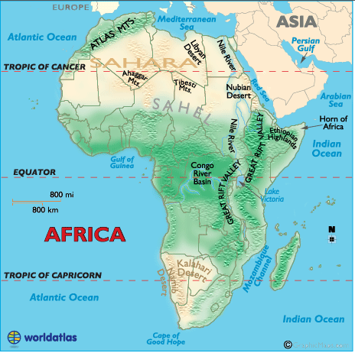
Notes:
Sub-Saharan Africa has very diverse landscapes and geographical or natural features. The
Congo River, for example, weaves its way 2850 miles to the Atlantic Ocean. It is also the Congo’s
highway for trade and travel. The Nile River is the longest river in the world, running north for
4241 miles. The Kalahari Desert is a vast desert in southern Africa that spreads over
southwestern Botswana. Lake Victoria, which is located in the country of Tanzania, is Africa’s
largest lake and one of the sources of the Nile River.

Slide 8
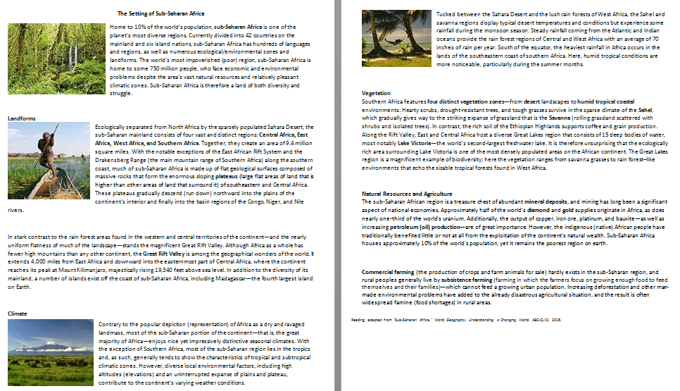
One Sentence Summary: Setting of Sub-Saharan Africa (30 min)
Purposeful Reading
Understanding the geography of sub-Saharan Africa.
Write a one sentence summary for each paragraph.
Notes:
Say: In today’s reading activity, we will learn more about the setting of Sub-Saharan Africa.
Say: Before we begin reading, we are going to complete a pre-reading activity.
Have students read the section titles from the reading and scan the text and images.
Say: The first thing we will look at is general overview of the region. I will read the first
paragraph of the document aloud. As I read aloud, I will stop to voice my thinking about the
text. I will also create a one sentence summary of what I have read underneath the paragraph.
Think Aloud
Read the first paragraph SLOWLY, stopping frequently to talk about what you are visualizing,
predicting, questioning, comparing or determining cause and effect.
Possible Think Aloud statements/questions/summary:
I imagine that the lifestyles of people living in sub-Saharan Africa greatly differ from
country to country.
I wonder if some areas of sub-Saharan Africa are as humid as Houston in the
summer time.
Summary: Sub-Saharan Africa has many natural resources, diverse areas, and
landforms; however, the region experiences many economic and environmental
problems.
Practice the strategy as a class, allowing a student volunteer to read the second paragraph and
create a summary as a class.
Say: Now look at the rest of the reading. Within your respective groups, you will complete the
rest of the reading, creating a one sentence summary at the end of each paragraph. Note, we
will stop periodically to check for understanding.

Slide 9
Checkpoint
Which landforms are characteristics of sub-Saharan Africa?
How would you describe the climate of sub-Saharan Africa?
What vegetation zones are present in the region?
Why might sub-Saharan Africa be considered a treasure chest?
What is the difference between commercial farming and subsistence agriculture?

Slide 10
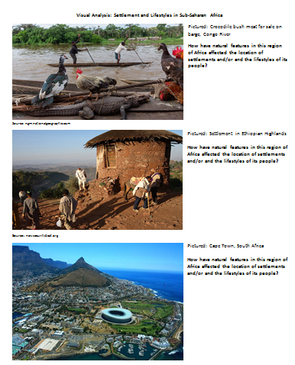
Visual Analysis: Settlement and Lifestyle (15 min)
Write 3 ways the natural features affected the location of settlements and/or the lifestyles of the people for each visual.

Slide 11
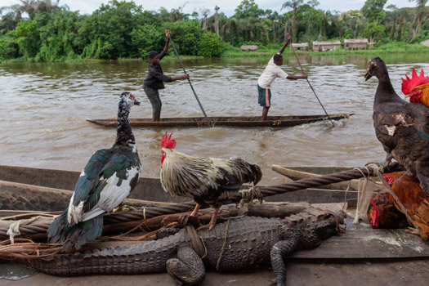
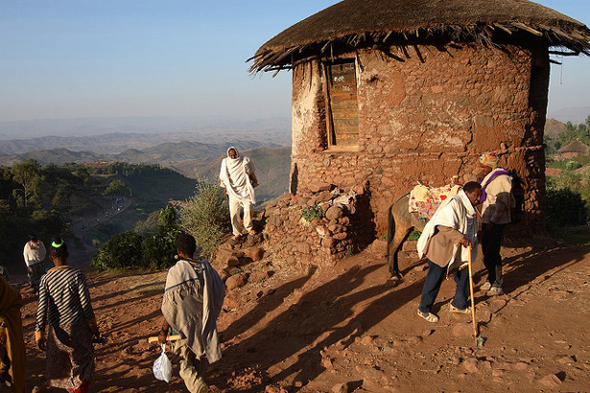
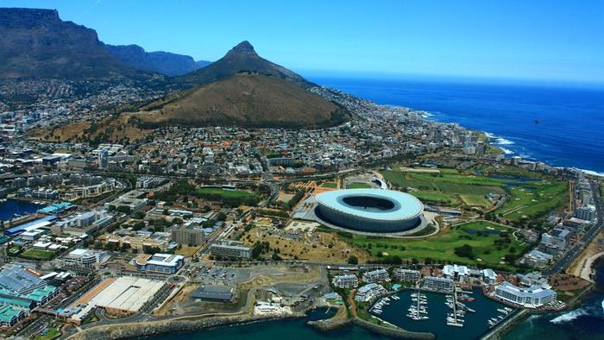
Mauritania - Sahel

Slide 12
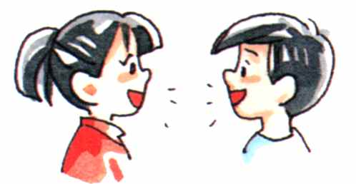
Checkpoint
In what ways do the natural features in sub-Saharan Africa affect the location of settlements and/or the lifestyles of its people?

Slide 13
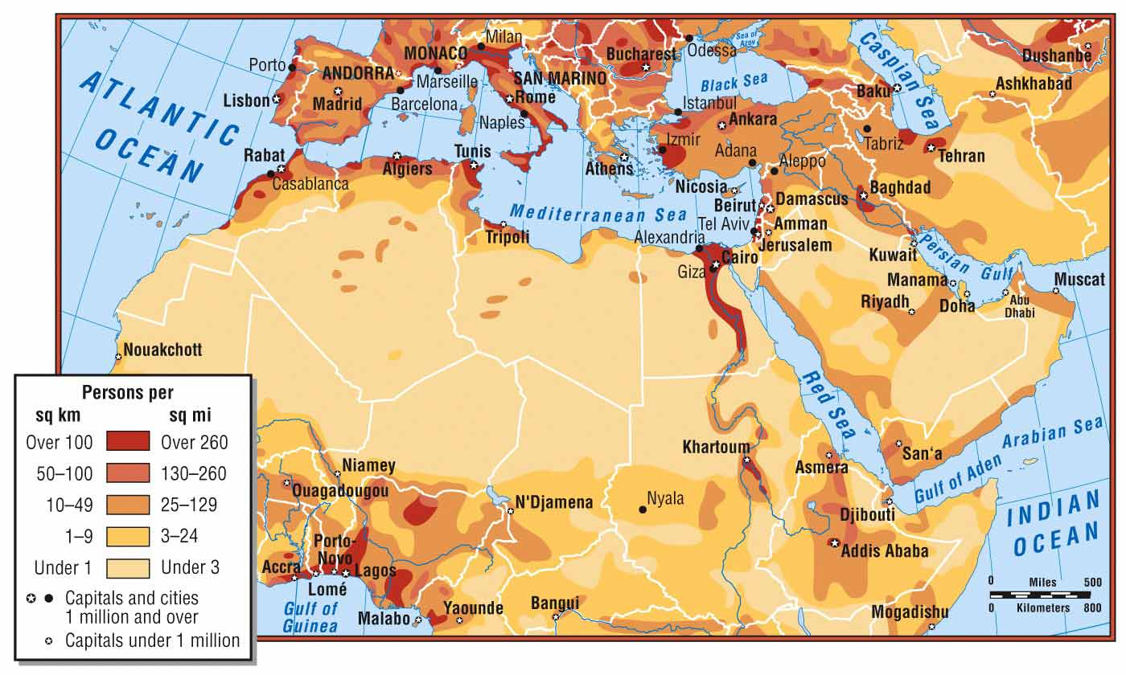
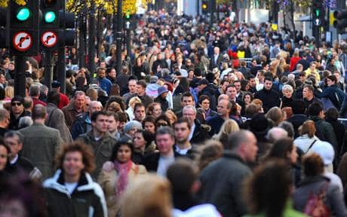
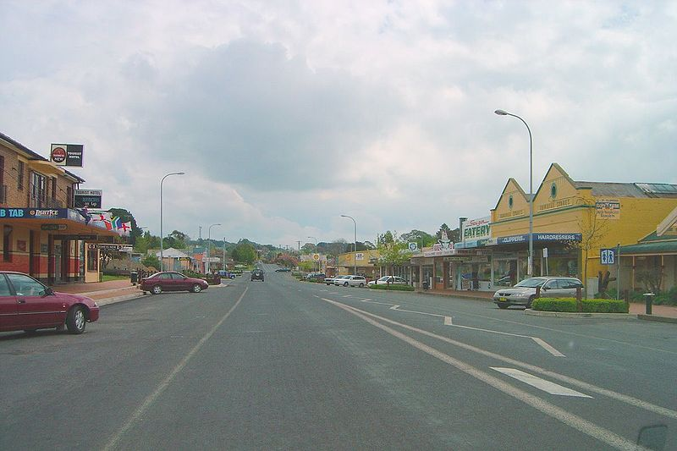
Population Density
The number of that live in a square area.

Slide 14
Checkpoint
What is population density?
What geographic features do people settle near most?

Slide 15
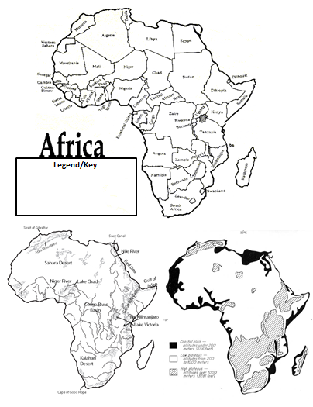
Create A Population Density Map – (20 min)
Colors needed for your legend
Yellow – very lightly populated
Orange – some
Red – many
Purple – heavily populated
Your task
Use the 2 physical maps on the bottom of the handout to create a population density map of Sub-Saharan Africa.

Slide 16
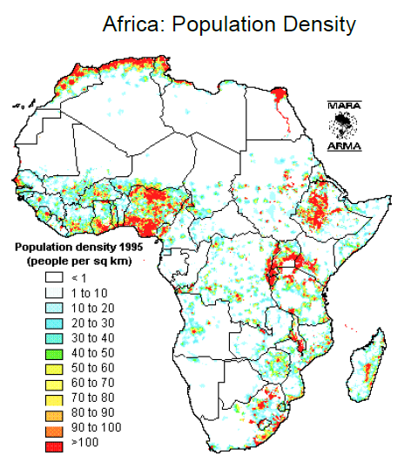
Exit Ticket

