Slide 1
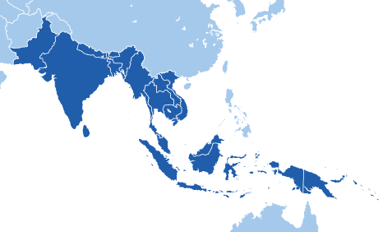
Do Now 11/8 – 9 eNvironment: Geography of S/SE Asia pg. 47-48
Choose a 3rd color to add to your world map.
Color the countries that are dark blue on your map.
Add this region to your legend.
Glue the ESP handout to the inside cover of your notebook

Slide 2
Paraphrasing – your own words
Action
creates
Physical Process—process that shapes features on Earth’s surface
Put a [bracket] around the words and phrases you want to keep.
These are words and phrases that are crucial because if you changed them it would change the meaning of the definition. The words you might want to keep include:
A proper noun
Statistics
Words that are unique or are difficult to find a synonym for
Now underline the words/phrases you can change

Slide 3
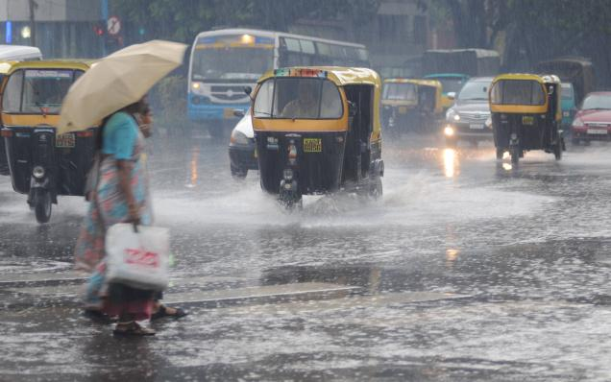
MONSOON
http://www.skymetweather.com/content/weather-news-and-analysis/bangalore-records-good-rain-exceeds-monthly-average/
Seasonal winds that blow steadily from the same direction for months (bringing rain) and affect a region’s climate.

Slide 4
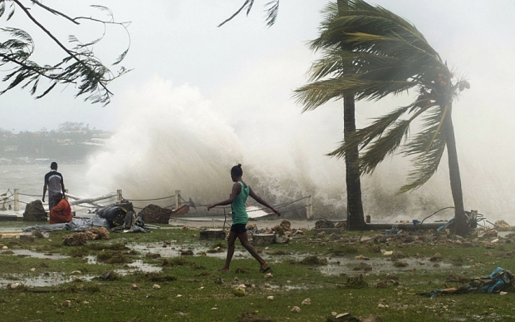
CYCLONE
http://www.telegraph.co.uk/news/worldnews/australiaandthepacific/vanuatu/11474092/Cyclone-Pam-aid-workers-describe-utter-devastation-in-Vanuatu.html
Intense tropical storms with strong winds and heavy rains often followed by deadly tidal waves.

Slide 5
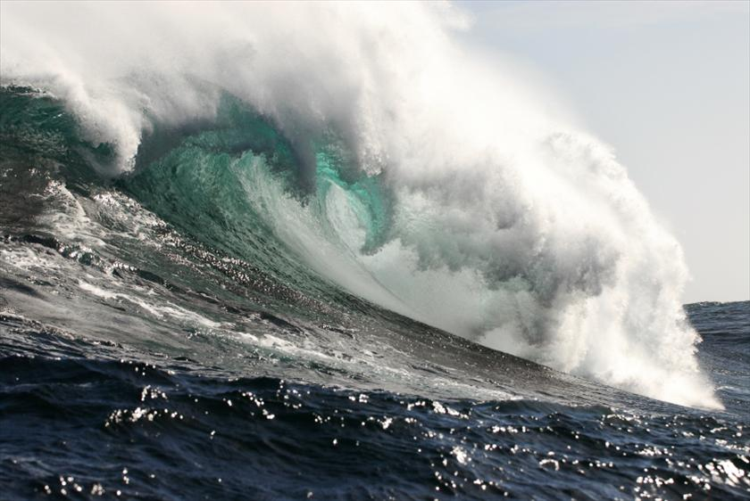
TSUNAMI
http://www.abc.net.au/science/articles/2010/03/04/2835659.htm
Huge waves caused by undersea earthquakes.

Slide 6
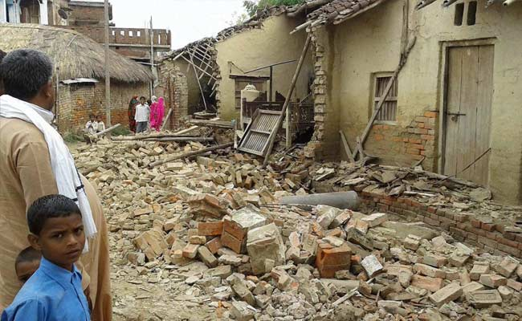
EARTHQUAKE
http://www.newindianexpress.com/galleries/2015/apr/27/Three-day-After-Effects-of-Repeated-Earthquakes-in-Nepal-2835.html
An upheaval on the earth’s surface causes by the movement of tectonic plates. Earthquakes are measured by the intensity of the tremor.

Slide 7
Checkpoint
What physical processes occur in South and Southeast Asia?
What happens during monsoon season?
What is the relationship between a tsunami and earthquake?
How is a cyclone different from a tsunami?
To what Gulf Coast physical process is a cyclone similar?

Slide 8
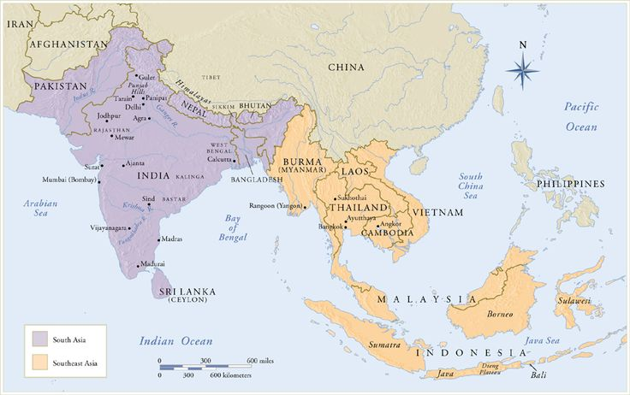
http://micro-robotics.com/AHCV/unit/3/SoutheastAsia/

Slide 9
Objectives
6.3A Pose and answer geographic questions, including: Where is it located? Why is it there? What is significant about its location? How is its location related to the location of other people, places, and environments?
6.4D Identify and locate major physical and human geographic features such as landforms, water bodies, and urban centers of various places and regions.
6.4F Identify the location of major world countries such as Canada, Mexico, France, Germany, the United Kingdom, Italy, Spain, Norway, Sweden, Russia, South Africa, Nigeria, Iraq, Afghanistan, Israel, Iran, India, Pakistan, the People's Republic of China, the Republic of China (Taiwan), Japan, North and South Korea, Indonesia, and Australia.
6.6A Describe and explain the effects of physical environmental processes such as erosion, ocean currents, and earthquakes on Earth's surface.

Slide 10
HOT QUESTION
How have landscapes [the Himalayas, numerous navigable rivers, and the Indian Ocean] and physical processes [monsoons, tsunamis, and earthquakes] both helped and hindered development in South/SE Asia?
Why am I learning this?
Physical processes and patterns have significant impact on the history and lifestyle in a region.

Slide 11
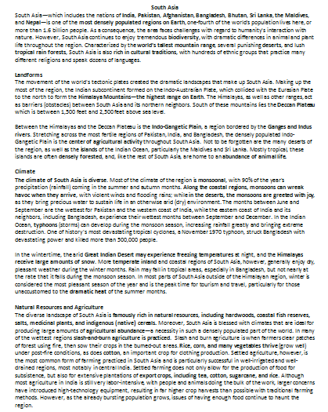
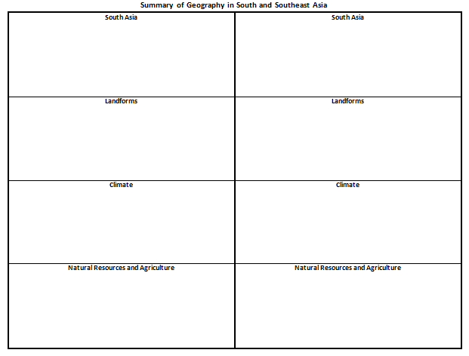
Gallery Walk Summarizing Geography of South/Southeast Asia
South Asia
South Asia Landforms
South Asia Climate
South Asia Natural Resources and Economic
Southeast Asia
Southeast Asia Landforms
Southeast Asia Climate
Southeast Asia Natural Resources and Economic
Read assigned section and write a one sentence summary.
Raise your hands to receive teacher approval for your summary.
Write the title of your section on the chart paper.
Write your one sentence summary and post near the sign for your section around the room.

Slide 12
Checkpoint
What landforms are in South and Southeast Asia?
Which landforms are barriers (obstacles) to travelers and invaders?
What is the climate for South Asia? Southeast Asia?
What is natural resources and agriculture is present in the South and Southeast Asia?

Slide 13
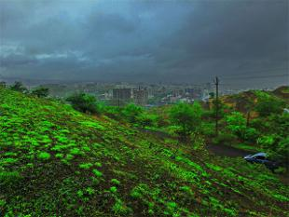
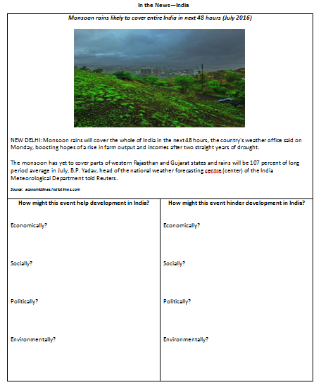
ESPN of Physical Processes
Read the news excerpts.
Devise ways the physical process would help or hinder [hold back] the region’s ESPN

Slide 14
Checkpoint
In what ways do the physical processes in South and Southeast Asia help the region?
In what ways do the physical processes in South and Southeast Asia hinder the region?

Slide 15
Formal Writing – ACES
Highlight 1 fact from the reading that proves that physical processes help the region.
Highlight 1 fact from the reading that proves that physical processes hinder the region.
Record these facts in the Cite Examples section of the ACES graphic organizer.
In the Explain section, write how these facts help and hinder the region.
Summarize the opinion.
Re-write the ACES in paragraph form.

Slide 16
Exit Ticket
Throughout history, earthquakes have had devastating effects on human settlements around the world.
Which is the best example of a supporting idea for the sentence above?
In 1924, there were no significant earthquakes in North and South America.
There have been numerous small earthquakes along the east coast of the United States.
Earthquakes have reduced whole sections of Tokyo and San Francisco to rubble.
Monsoons and earthquakes have had similar impact on countries in Southeast Asia.

