Slide 1
Do Now (5 minutes) 10/31 – 11/1 ESPN of Sub-Saharan Africa pg. 43-44
Label parts of the map (TODALSIG)
In the legend, identify each government as limited or unlimited.
Which continents have the most limited governments?
Which continents have the most unlimited governments?

Slide 2
European Imperialism Objectives
6.1A Trace characteristics of various contemporary societies in regions that resulted from historical events or factors such as invasion, conquests, colonization, immigration and trade.
6.5B Identify geographic factors such as location, physical features, transportation corridors and barriers, and distribution of natural resources that influence a society's ability to control territory.
6.8C Explain the impact of relative scarcity of resources on international trade and economic interdependence among and within societies.

Slide 3
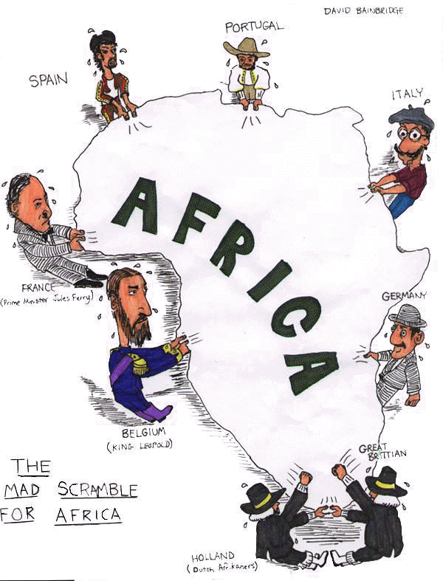
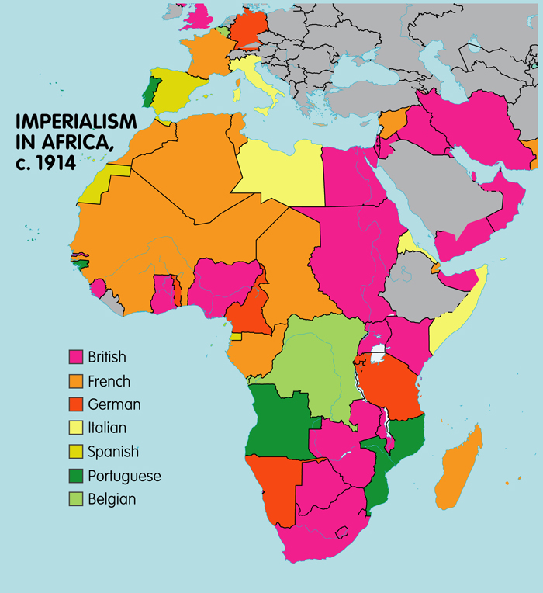
Turn and Talk: Summarize Imperialism in Sub-Saharan Africa
Somebody wanted…But…So…Then…

Slide 4
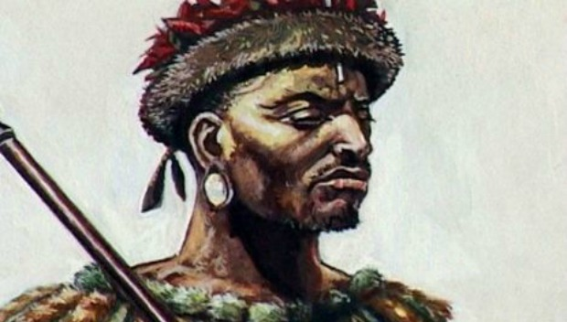
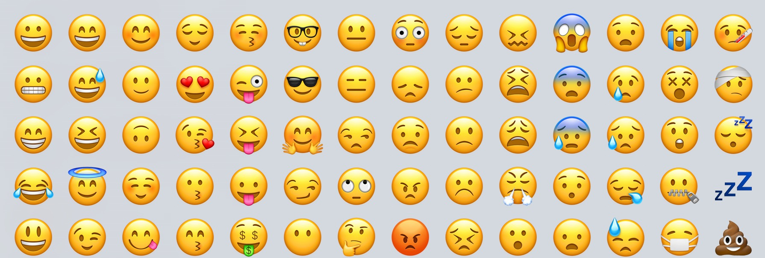
RAFT Writing (10 min)
Today I am [insert emotion]…
5-7 sentences
Use evidence from background to support thoughts.
Notes:
Using the background information to guide your writing, individually, you will now complete the RAFT writing assignment. You will play the role of a Young Zulu Warrior creating a journal entry about the invasion of Europeans on Zulu lands. You will have 5 minutes to complete this assignment.

Slide 5
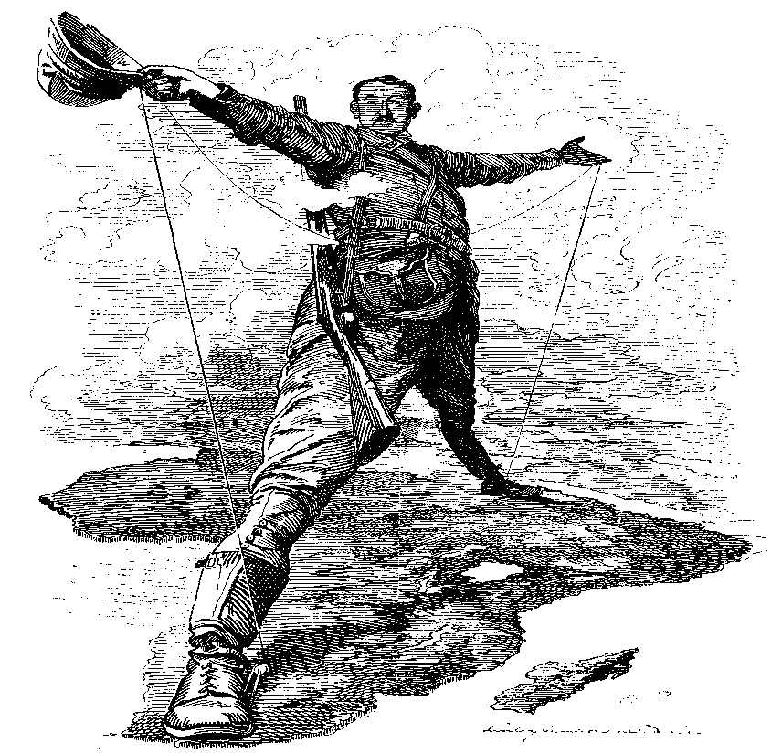
HOT Question
How and why did European nations colonize Africa?

Slide 6
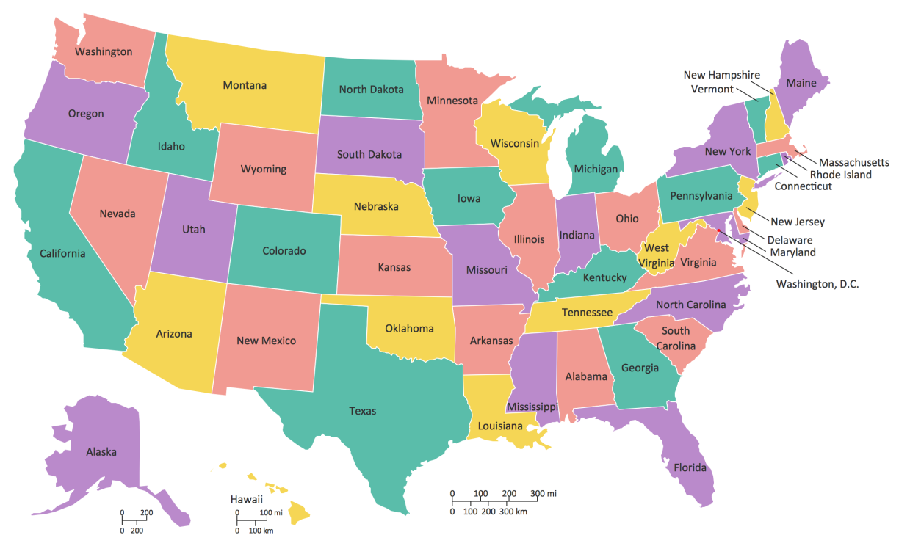
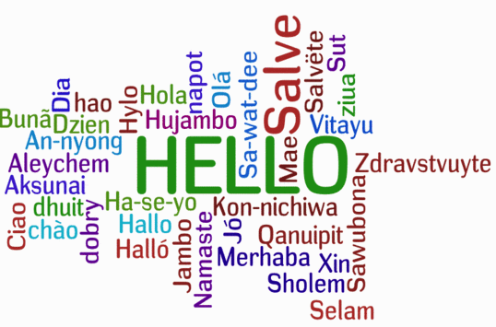
What if…? – Turn and Talk
What would it be like if every state in the United States had a different language?
What impact or effect might these language differences have on the nation and its people?
Source: elldiversity.wikispaces.com

Slide 7
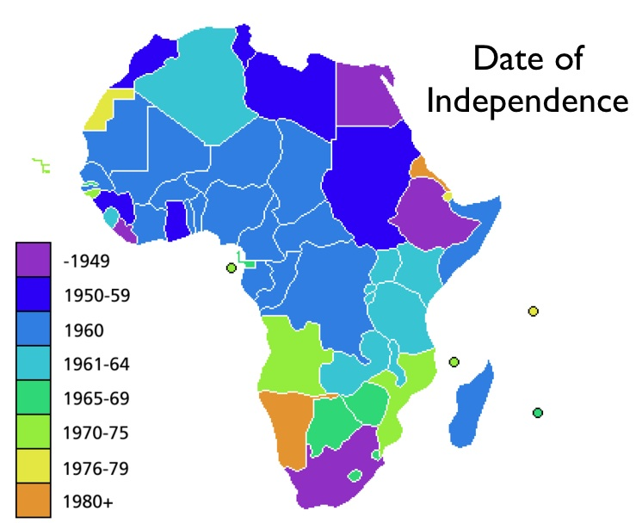
Objectives
6.15D Analyze the experiences and evaluate the contributions of diverse groups to multicultural societies. (sensory figure)
6.15E Analyze the similarities and differences among various world societies
6.15F Identify and explain examples of conflict and cooperation between and among cultures.

Slide 8
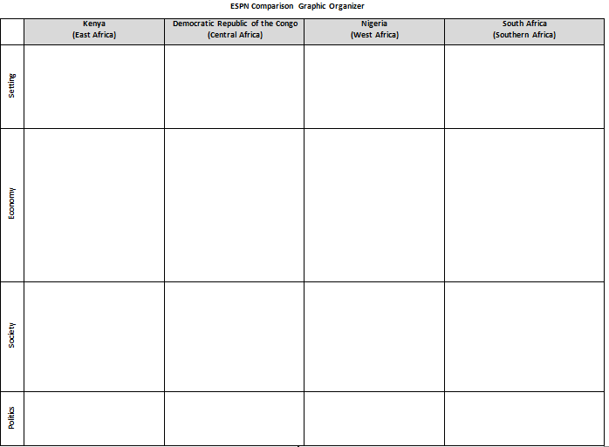
Jigsaw – Expert Groups
Meet with your expert groups.
Read to find ESPN for you country.
Complete ESPN chart as you read.
Look for these keywords:
Economic | Social | Political | eNvironment
Trading partners Agriculture Natural resources Poverty | Ethnic groups Language Religion | Type of government Conflict | Climate Landforms Waterforms

Slide 9
Checkpoint
What keywords should you look for when completing your chart?
Economics?
Social?
Political?
Environment?

Slide 10
Jigsaw – Mixed Groups
Share the ESPN of your country with your teammates.
The graphic organizer should be 100% complete in 15 minutes.

Slide 11
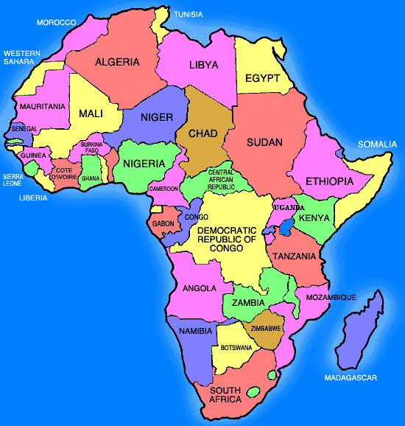
Checkpoint
What is the ESPN for…
Kenya?
Democratic Republic of Congo?
Nigeria?
South Africa?

Slide 12
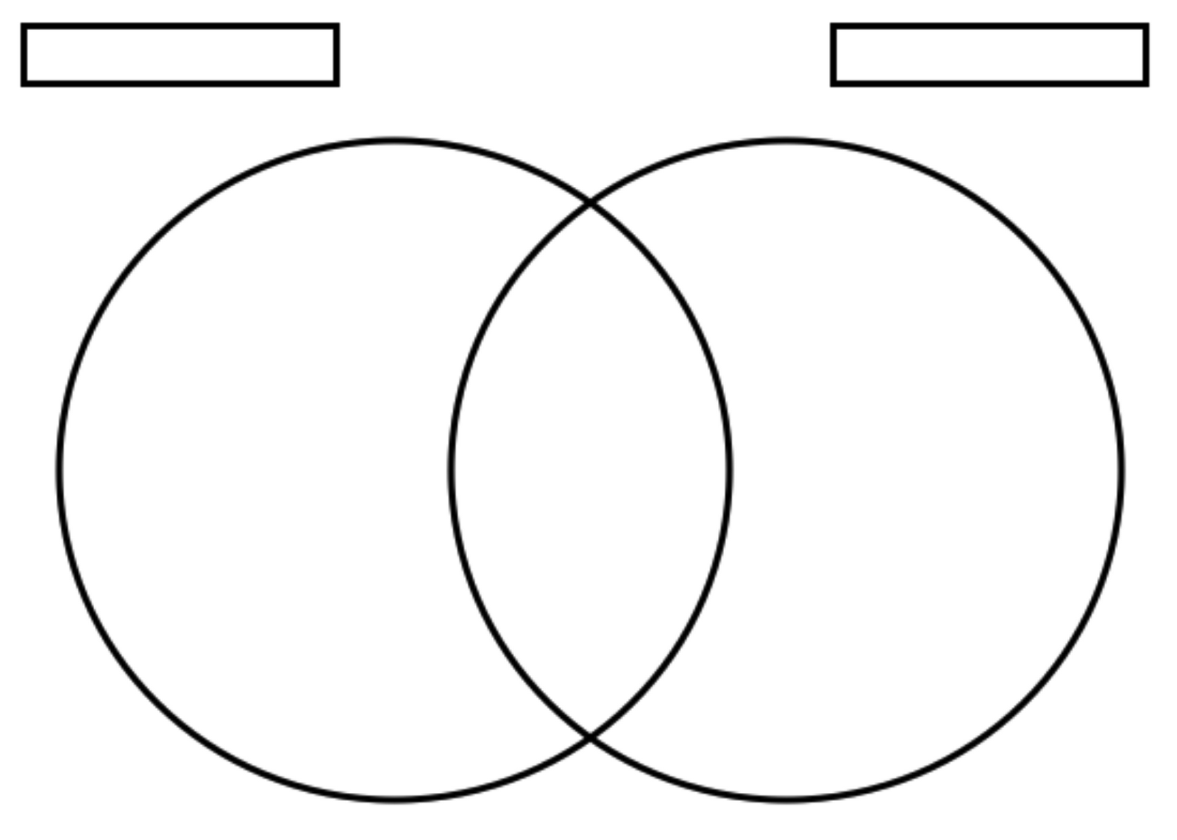
Venn Diagram
Choose 2 countries [Nation A & Nation B]
Identify 3 similarities and 3 differences among the nations.

Slide 13
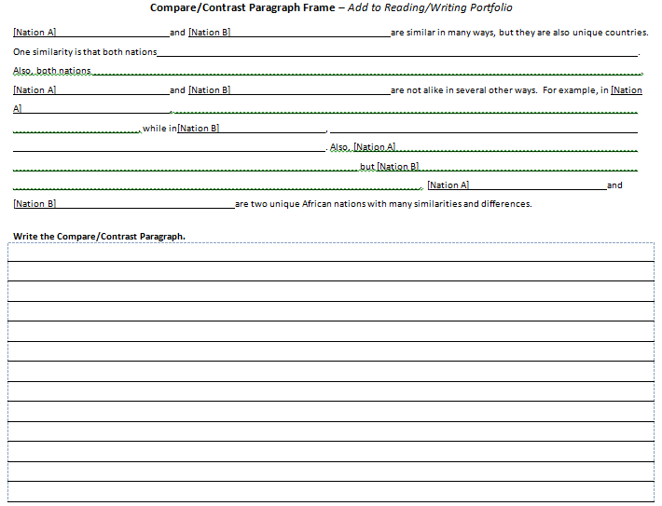
Compare/Contrast Paragraph
Use your Venn diagram to complete the paragraph frame.
Then write the paragraph on the lines.

Slide 14
Checkpoint – Round Robin
Everyone will share a similarity or a difference among the Sub-Saharan African countries.
You may not repeat what has been said.
You should have at least 3 ideas to share.

Slide 15
Exit Ticket

