Slide 1
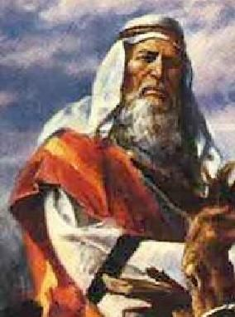
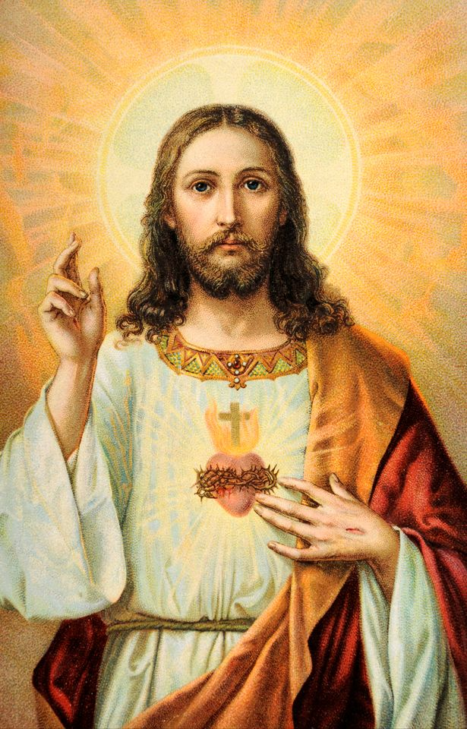
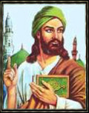
Do Now – 5 minutes 10/17-18 Religion in N Africa / SW Asia pg. 31-32
On page 31, write 2 similarities and 2 differences between the images.
Sentence stems:
One similarity among the images are… Another similarity is…
One difference is notice is… Another difference is…

Slide 2
Video Analysis – 5 minutes

Slide 3
Objectives
6.16B Compare characteristics of institutions in various contemporary societies (religion)
6.19A Explain the relationship among religious ideas, philosophical ideas, and cultures
6.19B Explain the significance of religious holidays and observances such as Christmas, Easter, Ramadan, the annual hajj, Yom Kippur, Rosh Hashanah, Diwali, and Vaisakhi in various contemporary societies.
6.21B Analyze information by sequencing, categorizing, identifying cause-and-effect relationships, comparing, contrasting, finding the main idea, summarizing, making generalizations and predictions, and drawing inferences and conclusions

Slide 4
Words of the Day
Monotheism
Polytheism
Judaism
Christianity
Islam
Qur’an
Bible
Torah

Slide 5
Religion
a strong belief in a supernatural power or powers that control human life
Major World Religions
Christianity
Judaism
Islam

Slide 6
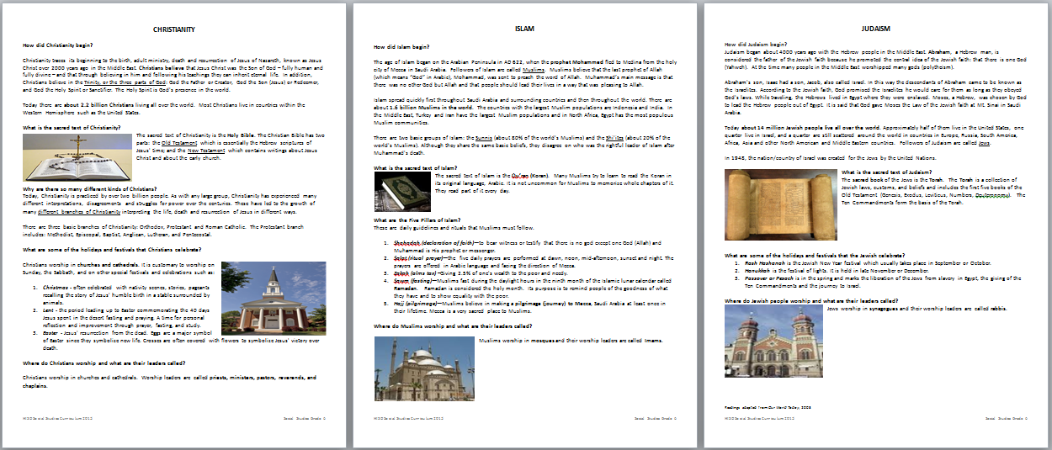
Jigsaw
Home Group: Mixed Colors
Expert Group: Same Colors

Slide 7
Monotheistic Religion Jigsaw
Part One:
Meet with same color team members.
Read the handout together.
Complete the graphic organizer for your assigned religion.
Part Two:
Return to your home groups.
Share your new learning.
All graphic organizers must be 100% complete.

Slide 8
Checkpoint
What is a monotheistic religion?
What 3 religions originated in the Middle East?
What are the beliefs of each religion?
What is the holy book of each religion?
Who are the worship leaders of each religion?

Slide 9
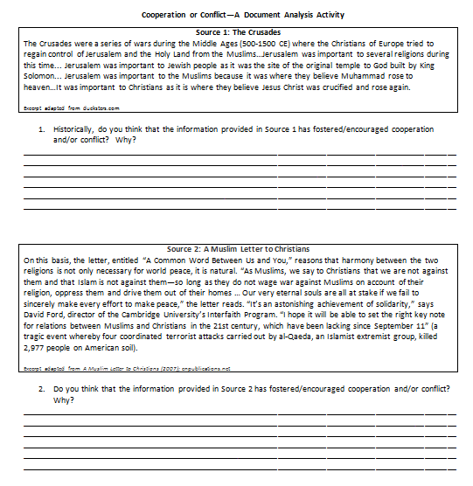
Cooperation or Conflict?
Follow along as a read each document.
You will respond to the questions independently.

Slide 10
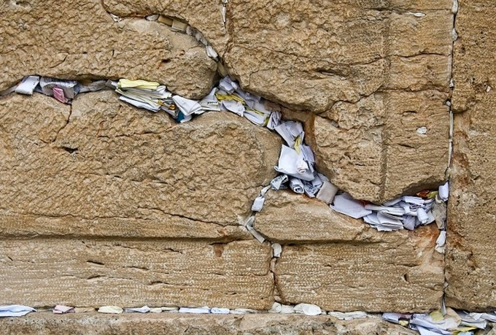
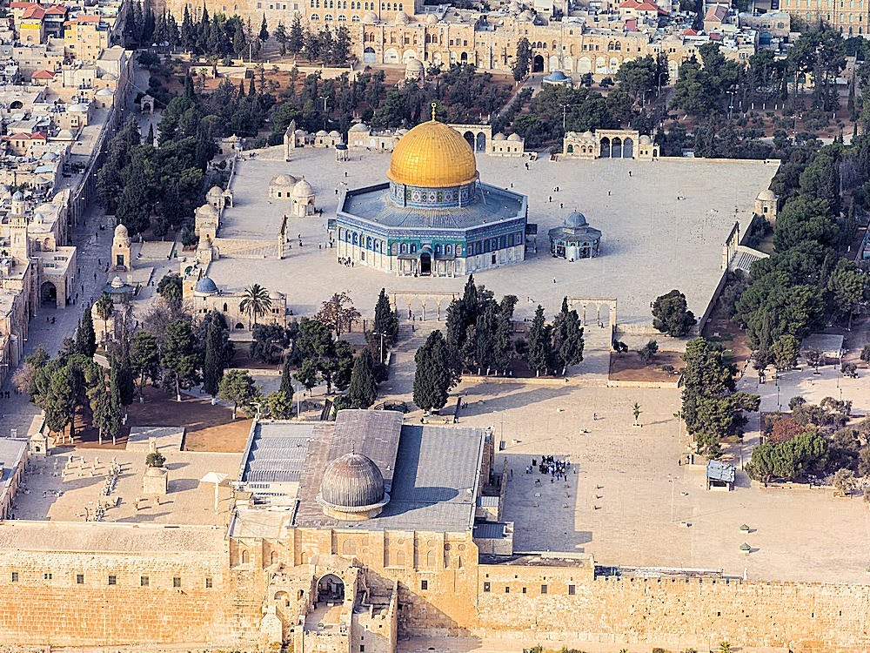
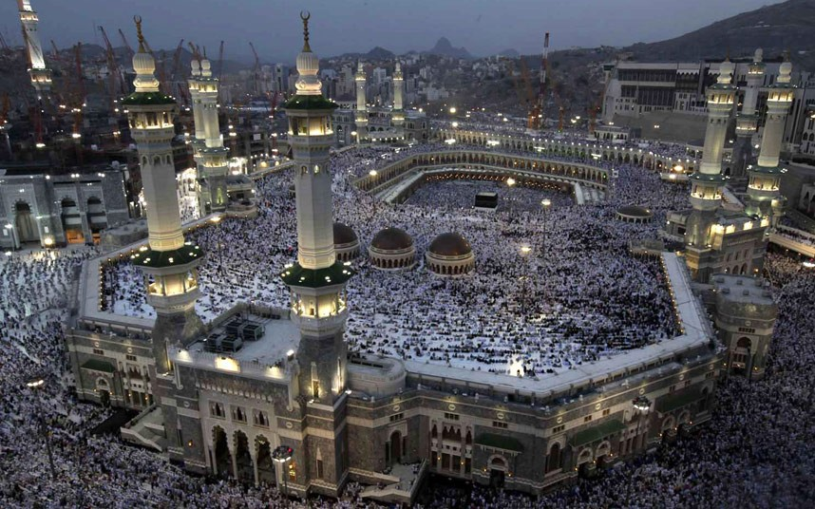
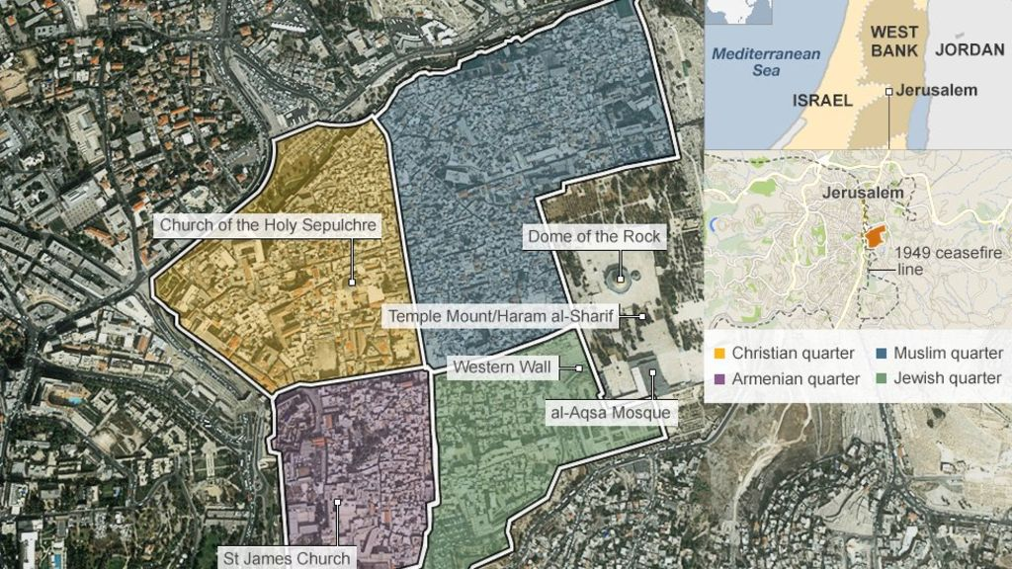

Slide 11
Checkpoint
What 3 religions have fostered cooperation or conflict in the Middle East?
How might religion cause conflict in the region?
In what ways is there cooperation among these religions?

Slide 12
A.C.E.S. Writing Reminders
Facts
come directly from the text
not your own words
Explain
how does your evidence prove/show that there is conflict and cooperation in religion

