Slide 1
Do Now – 10 minutes 10/19-20 Zombie Diaries: SW Asia/North Africa pg. 35-36
Write 5 sentence note about your day to your parent on pg. 35.
You must include:
A greeting
2 things you did today (2 sentences)
Your opinion about your day
Closing

Slide 2
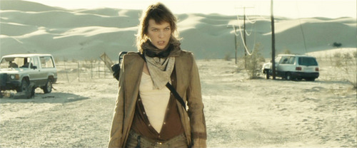
Objective
To begin planning for Zombie Postcards

Slide 3
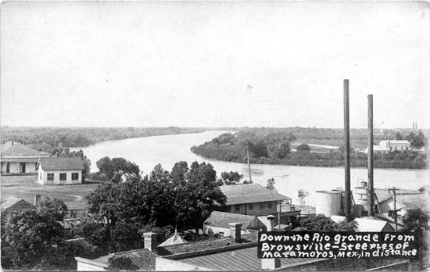
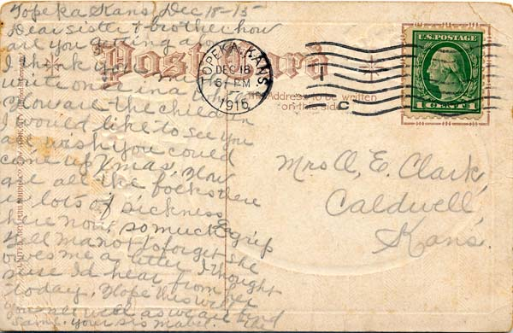
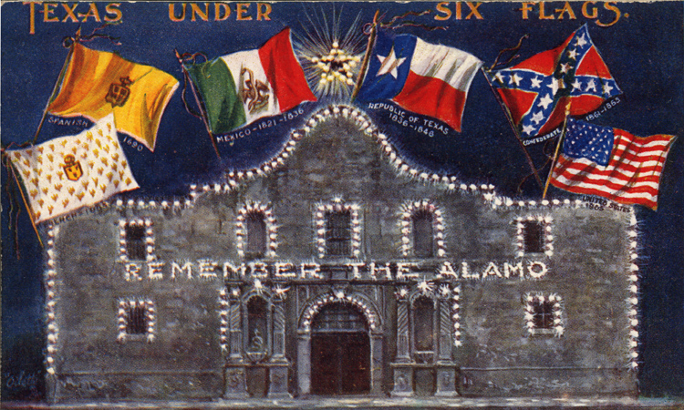
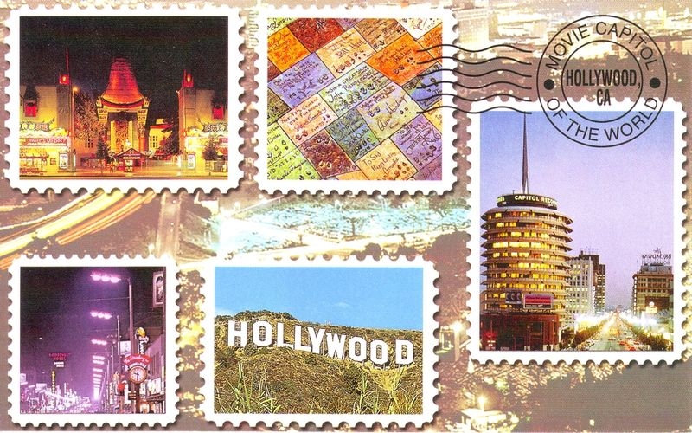
What is a postcard?
A short note written to loved ones about your travels
Shows the characteristics of a place such as geography or culture
Address of the person to whom you are sending the postcard

Slide 4
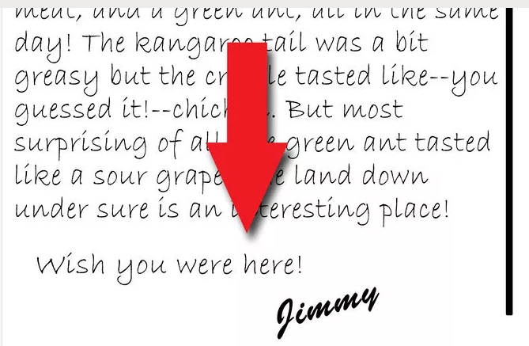
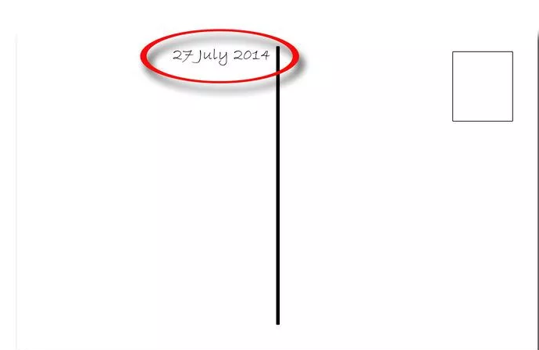
How to write on a postcard…

Slide 5
Your template…
Date
Greeting,
Tell the reader where you are
First characteristic about the topic
Second characteristic about the topic
Your opinion of the place/characteristics
Closing,
Your first and last name

Slide 6
How Do I Earn 7-8?
5 postcards
Geography
Ancient Civilizations
Economic Resources
Religious Refuge (Shelter) and Solace (Help)
Current Events in Syria
Must be entirely colored – no white space!!
Must be written legibly and in ink
Must use classwork as a source

Slide 7
Dear Mom,
Zombies chased me across the desert and into Jerusalem. The only place I could find solace was at a Mosque. I discovered that Islam is the religion of most people in SW Asia and North Africa. The mosque is very beautiful and peaceful!
See you soon!
Mrs. Battiste
Source: Religion in the Middle East Graphic Organizer

Slide 8
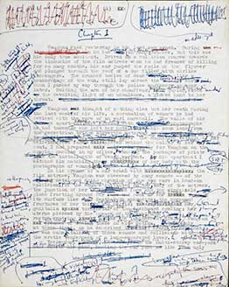
Exit Ticket

