Slide 1
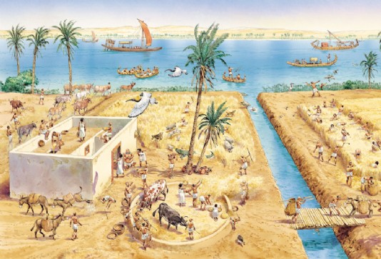
Do Now – (10 min) 10/26 – 10/27 Ancient Civilizations pg. 33 – 34
Use the sentence stems to answer in complete sentences. DO NOT WRITE THE QUESTIONS!! (on pg. 33)
What in the image suggests that this civilization was able to survive in the desert?
The civilization in the image is able to survive in the desert because the images shows…
What are 3 ways the water source can be used?
Three ways the fresh water source can be used is…

Slide 2
Objectives (2 min)
6.1A Trace characteristics of various contemporary societies in regions that resulted from historical events or factors such as invasion, conquests, colonization, immigration and trade.
6.2B Evaluate the social, political, economic, and cultural contributions of individuals and groups from various societies, past and present.
6.21A Differentiate between, locate, and use valid primary and secondary sources such as computer software, interviews, biographies, oral, print, and visual material, and artifacts to acquire information about various world cultures.
6.21B Analyze information by sequencing, categorizing, Identifying cause-and-effect relationships, comparing, contrasting, finding the main idea, summarizing, making generalizations and predictions, and drawing inferences and conclusions.

Slide 3
Inquiry Question (1 min)
How do contributions of early civilizations impact people’s lives in the 21st century?
Statement of Inquiry
Ancient civilizations, all originally established in fertile river valleys, left contributions in religion, government, mathematics, art, architecture and other fields that impact people’s lives today.
Approach to Learning
Critical Thinking

Slide 4
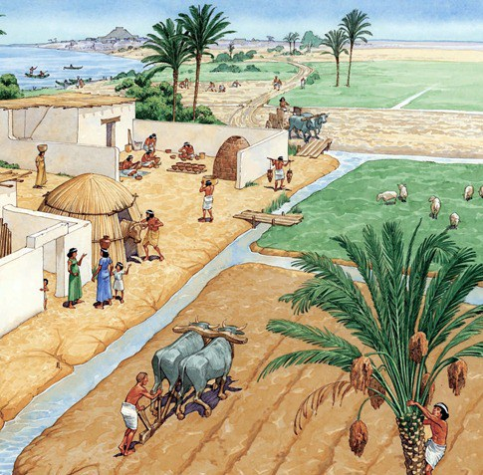
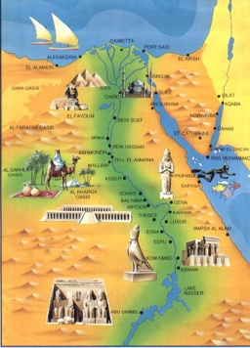
Words of the Day!! Ancient Civilizations
Civilization
A complex, urbanized (city-like) society with significant levels of development in government, religion, economics, and culture.
Ancient
Very old; occurring many centuries ago.

Slide 5
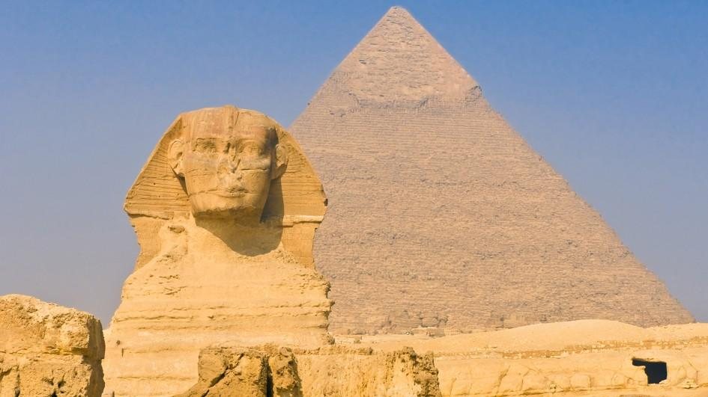
Engage
Think about It!
When do you think it was built?
How do you think it was built?
Why do you think it is important?
http://kids.nationalgeographic.com/explore/countries/egypt/#egypt-pyramids.jpg

Slide 6
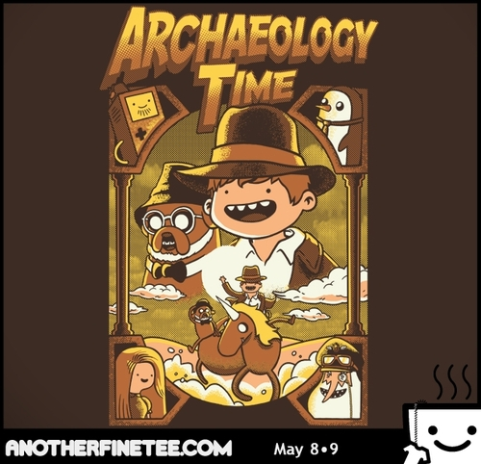
Archeological Find!
A huge discovery has been made!
A series of secondary source documents and artifacts were found and historians around the world are excited to see what valuable information they hold.
Your job is to closely examine the documents and artifacts to answer the following big question:
Which civilization made the greatest contribution to modern-day societies?

Slide 7
Document 2: Hieroglyphics
Around 3000 B.C., The Ancient Egyptians invented a writing system based on symbols called hieroglyphics. Hieroglyphics provide a look into Egypt’s past—particularly, in regards to religion, culture, and government in the ancient civilization. For example, the Rosetta Stone, a text written by a group of priests in Egypt in 196 B.C. to honor the Egyptian pharaoh, was partly written in Egyptian hieroglyphics. It lists all of the things that the pharaoh did for the priests and the people of Egypt.

Slide 8
Checkpoint
What contributions of Mesopotamia impact our lives in the 21st century in the areas of…
Trade and Innovation?
City-States and Agriculture?
Babylonian Code of Law?

Slide 9
Checkpoint
What contributions of Ancient Egypt impact our lives in the 21st century in the areas of…
Mathematics?
Hieroglyphics?
The Egyptian Pyramids?

Slide 10
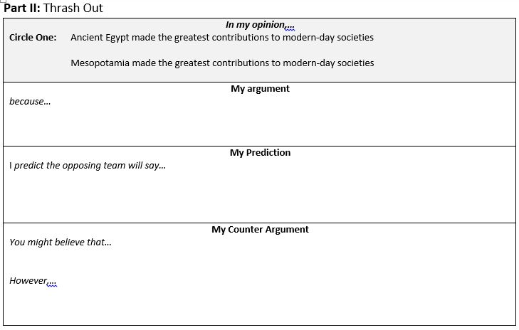
Thrash Out
Mesopotamia domesticated animals and were one of the first farmers.
Ancient Egypt gave us ideas about architecture and math that we still use today.
Math and architecture is important.
Without farming and irrigation techniques we will all have to hunt for our food. Also, we wouldn’t have pets if animals were never domesticated.

Slide 11
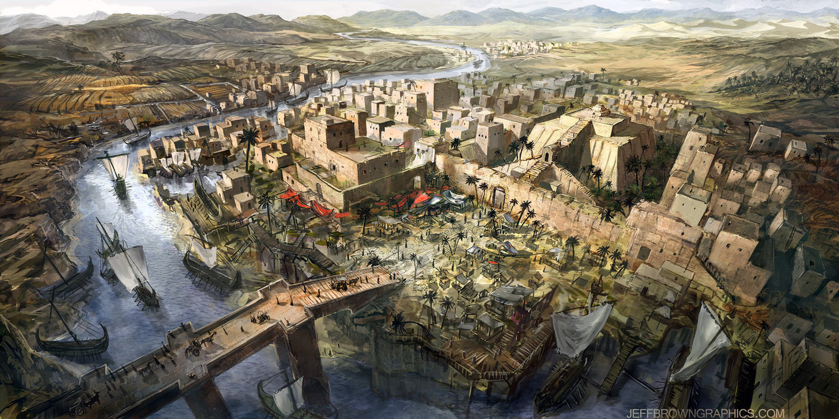
ACES Writing
Which civilization made the greatest contribution to modern-day societies?
.

Slide 12
Checkpoint
How did river valleys contribute to urbanized societies?

Slide 13
Clean Up & Exit Ticket
Your table should look like the image below.
Grab a plicker card when you are done with your do now.

