Slide 1
DO NOW (10 min) 10/12 ESPN: Economic $ystems PG. 19-22
Create a factors of production chart for the product on the right
Be sure to include:
Land (3 examples)
Labor (3 examples)
Capital (3 examples)
Entrepreneurship
If you finish early – organize your notebook. (glue in loose sheets, number pages, etc.)
Respond on page 19
Is your week sheet out and ready to be stamped?
Did you write today’s lesson title in your table of contents?

Slide 2
DO NOW (15min) 10/12 ESPN: Economic $ystems PG. 19-22
Complete the IB Reflection handout.
You MUST write in complete sentences.
Be sure your name is on your paper.
Is your week sheet out and ready to be stamped?
Did you write today’s lesson title in your table of contents?

Slide 3
IB Reflection Stems
________ helped me complete this project because I …
The purpose of the assignment was to create a map that showed…
The steps that I had to take to complete the project was…
I was motivated to work hard because…
I learned…
I was/was not satisfied with my work because…
If I could revise my work, I would…

Slide 4
QSSSR – 5 min
Questions: Who should decide the price of the car? Who should decide who gets to purchase the car?
Stem: Select one of the options to complete the stems.
individuals
a company
the government
“I think _____________ should decide the price of the car because…”
“I think _____________ should decide who gets to purchase the car because…”
Signal: timer sounds in 2 minutes
Share: The person with the longest hair goes first.
Assess: Share whole group.
$260,000

Slide 5
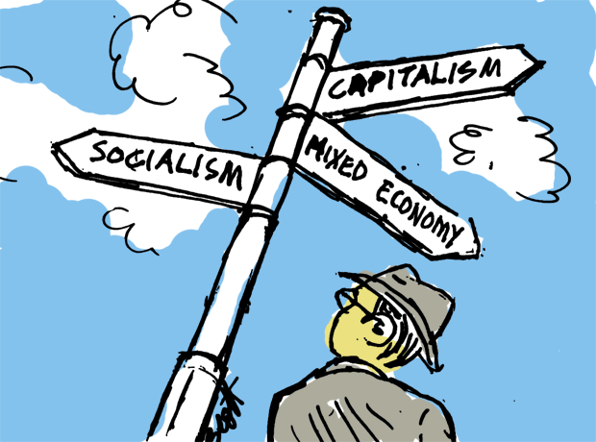
Objectives
6.8A Describe ways in which the factors of production (natural resources, labor, capital, and entrepreneurs) influence the economies of various contemporary societies
6.21B Analyze information by sequencing, categorizing, identifying cause-and-effect relationships, comparing, contrasting, finding the main idea, summarizing, making generalizations and predictions, and drawing inferences and conclusions;

Slide 6
Inquiry Question
What are the differences between traditional, market, and command economies?
Statement of Inquiry (SOI)
Economic systems allow people to organize the production and distribution of goods and services.
Approach to Learning
Social:
Collaboration

Slide 7
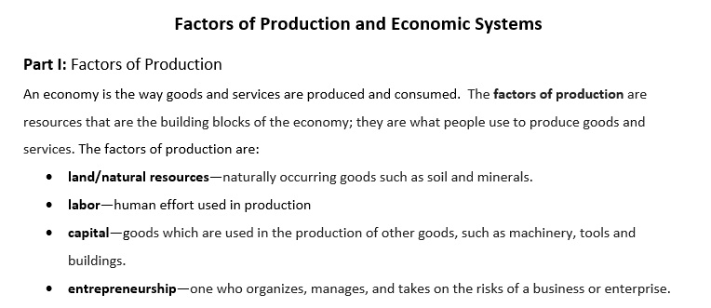
Economic Systems – 30 min

Slide 8
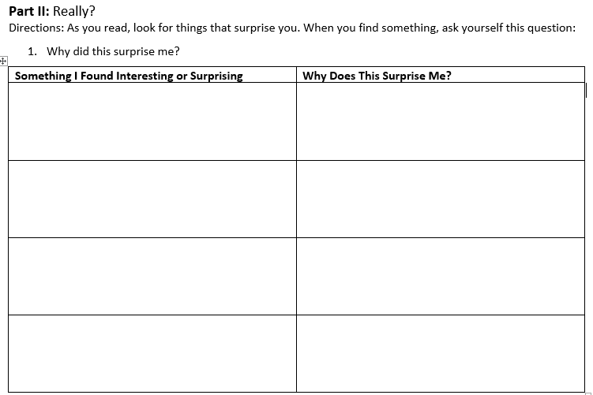
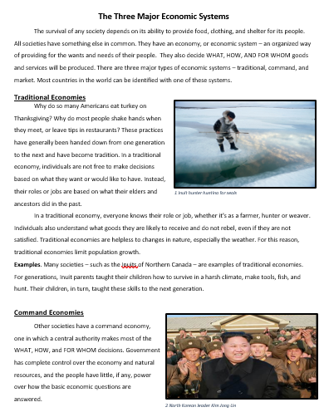
Economic Systems
Coding Text

Slide 9
Checkpoint
What is an economic system?
What three questions must all economic systems answer?
What are the three types of economic systems?

Slide 10
Checkpoint
What are the characteristics of a traditional economic system?
What are the characteristics of a command economic system?
What are the characteristics of a market economic system?

Slide 11
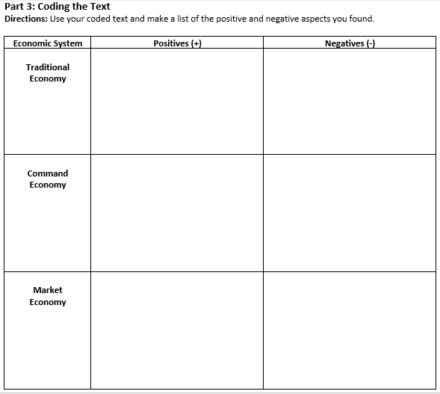
Economic Systems
Coding Text
Positive (good) +
Negative (bad) -

Slide 12
Checkpoint
What are the benefits and drawbacks of a traditional economic system?
What are the benefits and drawbacks of a command economic system?
What are the benefits and drawbacks of a market economic system?

Slide 13
Part III: Discussion Starter
Which of the three economic systems would you associate with the United States? Why?
Based on what I have learned, I think…

Slide 14
Inquiry Question
What are the differences between traditional, market, and command economies?

Slide 15
ACES – Formal Writing
Prompt: In your opinion, which economic system is better—a command or market economy?
Is there a time/place that is necessary for you to know in order for you to complete this ACES writing?
What are the important terms that you must keep in mind as you write?
economic system, better, market economy, command economy

Slide 16
ACES – Formal Writing
Prompt: In your opinion, which economic system is better—a command or market economy?
THESIS = SUBJECT + OPINION
BONUS!! – Your opinion is on Part III of your handout.
Record on butcher paper.

Slide 17
ACES – Formal Writing
Prompt: In your opinion, which economic system is better—a command or market economy?
EVIDENCE?
Use the handouts! (Text or graphic organizer)
The evidence comes DIRECTLY from the text.

Slide 18
ACES – Formal Writing
Prompt: In your opinion, which economic system is better—a command or market economy?
EXPLAIN…
“Because.” is not good enough!!
Explain WHY your facts/evidence support your opinion.

Slide 19
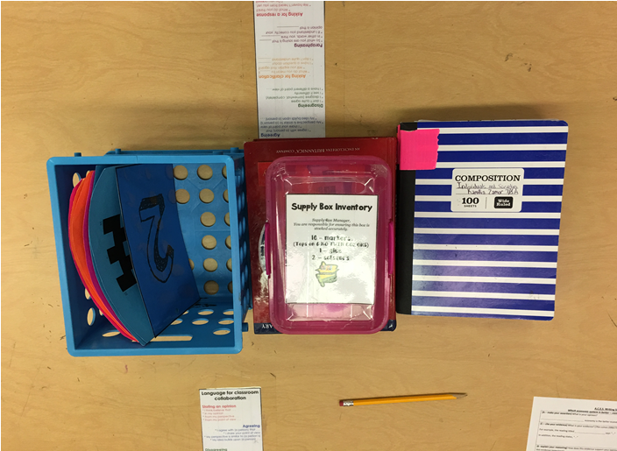
Ready To Go?
You are NOT ready to go until your table looks like this
Difference:
Have your plicker card in your hand!

Slide 20
Exit Ticket
Which of the following is a valid [correct] conclusion about economic systems? 6.8A
Economic freedom is most limited in a market economy.
Government authority is strongest in a command economy.
Competition is a key factor in all the economies listed.
The profit motive drives all business in a traditional economy.

