Slide 1
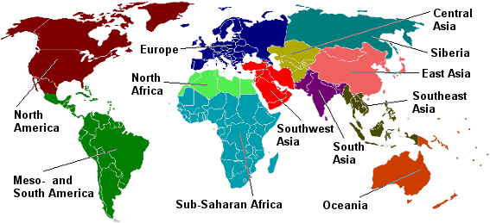
Cultural Region (2 min)
Glue the world map on the inside cover of your notebook
We will color the regions as we study them throughout the year.

Slide 2
Regions of Study
SW Asia & North Africa
Sub-Saharan Africa
South/Southeast Asia
East Asia
Europe
Russia & the Eurasian Republics
North America & the Caribbean
South America

Slide 3
Objectives (3 min)
6.3A Pose and answer geographic questions, including: Where is it located? Why is it there? What is significant about its location? How is its location related to the location of other people, places, and environments?
6.4B Identify and explain the geographic factors responsible for patterns of population in places and regions.
6.21B Analyze information by sequencing, categorizing, identifying cause-and-effect relationships, comparing, contrasting, finding the main idea, summarizing, making generalizations and predictions, and drawing inferences and conclusions

Slide 4
Inquiry Question (=HOT Question)
Which physical and human geographic factors affect settlement patterns and population distributions most?
Statement of Inquiry (SOI) (=Essential Understanding=Purpose for Learning)
Varieties of human and physical factors AFFECT settlement patterns and population distributions.
Approaches to Learning Skills (ATL)
(=21st Century Skills)
THINKING: Transfer*
*Apply skills and knowledge in an unfamiliar scenario

Slide 5
Words of the Day!!!
regions
physical regions
human (cultural) regions

Slide 6
Engage (5 min)
Record the sentence stems in your notebook on page 10.
I see…
I know (background knowledge)…
Based on what I see and know, I can infer…

Slide 7
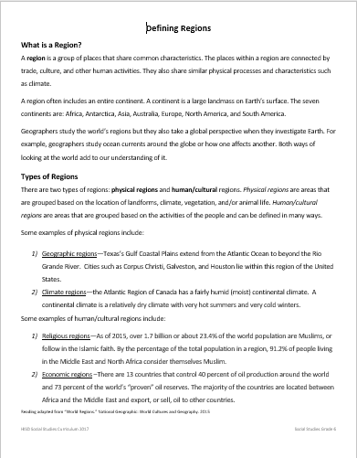
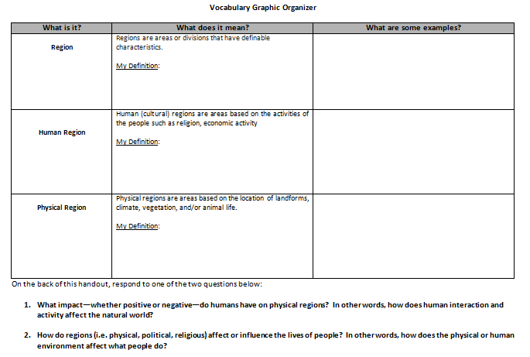
Direct Instruction – 22 min

Slide 8
What is a Region?
A region is a group of places that share common characteristics. The places within a region are connected by trade, culture, and other human activities. They also share similar physical processes and characteristics such as climate.
A region often includes an entire continent. A continent is a large landmass on Earth’s surface. The seven continents are: Africa, Antarctica, Asia, Australia, Europe, North America, and South America.
Geographers study the world’s regions but they also take a global perspective when they investigate Earth. For example, geographers study ocean currents around the globe or how one affects another. Both ways of looking at the world add to our understanding of it.

Slide 9
Types of Regions
There are two types of regions: physical regions and human/cultural regions. Physical regions are areas that are grouped based on the location of landforms, climate, vegetation, and/or animal life. Human/cultural regions are areas that are grouped based on the activities of the people and can be defined in many ways.

Slide 10
Some examples of physical regions include:
Geographic regions—Texas’s Gulf Coastal Plains extend from the Atlantic Ocean to beyond the Rio Grande River. Cities such as Corpus Christi, Galveston, and Houston lie within this region of the United States.
Climate regions—the Atlantic Region of Canada has a fairly humid (moist) continental climate. A continental climate is a relatively dry climate with very hot summers and very cold winters.

Slide 11
Some examples of human/cultural regions include:
Religious regions—As of 2015, over 1.7 billion or about 23.4% of the world population are Muslims, or follow in the Islamic faith. By the percentage of the total population in a region, 91.2% of people living in the Middle East and North Africa consider themselves Muslim.
Economic regions –There are 13 countries that control 40 percent of oil production around the world and 73 percent of the world’s “proven” oil reserves. The majority of the countries are located between Africa and the Middle East and export, or sell, oil to other countries.

Slide 12
Checkpoint – 3 min
What are the 2 categories of regions?
Provide an example of each region.

Slide 13
Card Sort: Silent Communication
Picture | Location & Description | Human/Cultural or Physical
4 images | 4 descriptions | 2 human 2 physical

Slide 14
Checkpoint - Reflection
Respond to the following question on page 10 of your notebook.
Which physical and human geographic factors affect where people settle the most? Why?
The physical geographic factors that affect where people settle is… because…
Glue your graphic organizer to the BOTTOM HALF of the reading (ON THE BLANK SIDE)
Glue the reading to page 10. NO GLUE ABUSE!!!!

Slide 15
Independent Practice – 25 min
Imagine that you are living in a different region of the world.
Using your assigned image and your imagination, answer the questions on the handout
Create a journal entry detailing your life and daily activities in the region.

Slide 16
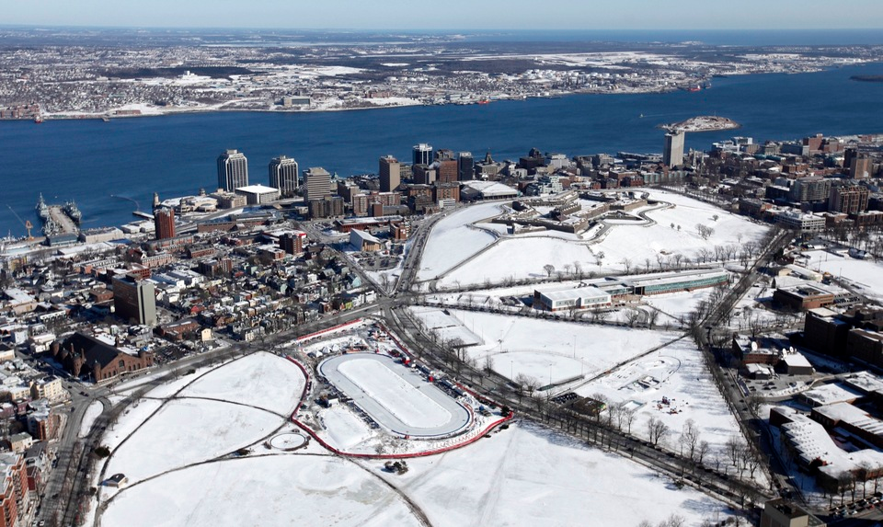
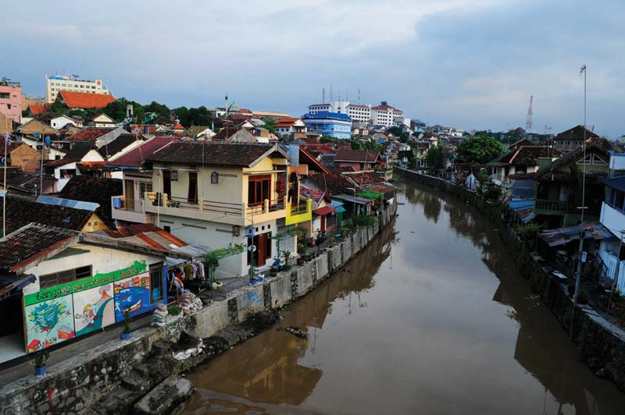
Dear Diary,
It was hard driving to the office in the snow, but I made it safely. I can’t wait to play ice hockey this weekend with the club. On Sunday, I’ll build snowmen with the neighborhood kids.
Dear Diary,
I made a few extra dollars offering boat rides up and down the river. The fish weren’t biting much today. Maybe they will be hungry tomorrow. I need to collect an extra bucket of water from the river for the soup tonight. If we boil the water, it will be safe to drink.

Slide 17
Exit Ticket 7 min

