Slide 1
Do Now – 7 minutes → Write your answer on the top half of page 1 in your notebook IN COMPLETE SENTENCES!! → Have your week sheet ready or risk losing points. → Table of Contents: Creating Maps pg. 1-2
What is a map?
Why do we use maps?
List as many types of maps as you can.

Slide 2
Objectives – 3 min
SS.6.3D Create thematic maps, graphs, charts, models, and databases depicting [showing] aspects [features] such as population, disease, and economic activities of various world regions and countries
SS.6.4A Locate various contemporary societies on maps and globes using latitude and longitude to determine absolute location.
SS.6.21C Organize and interpret information from outlines, reports, databases, and visuals, including graphs, charts, timelines, and maps.
SS.6.21F Use appropriate mathematical skills to interpret social studies information such as maps and graphs

Slide 3
Write our ESSENTIAL UNDERSTANDING & GUIDING QUESTION in your notebook. (4 MIN)
Essential Understanding
Graphic representations of information and data often express relationships and patterns in the physical and human geography of a place/region.
Guiding Question
What are the key elements of a map?

Slide 4
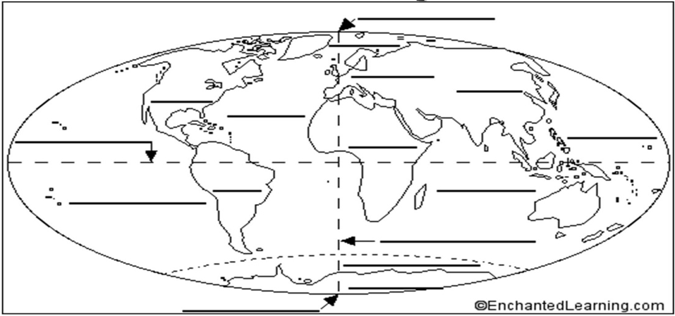
Engage: 12 minutes
North Pole
Europe
North America
Asia
Atlantic Ocean
Equator
Pacific Ocean
Africa
South America
Indian Ocean
Pacific Ocean
Australia
Prime Meridian
Southern Ocean
Antarctica
South Pole

Slide 5
Checkpoint – 3 min
What is a continent?
What do you notice about the oceans?

Slide 6
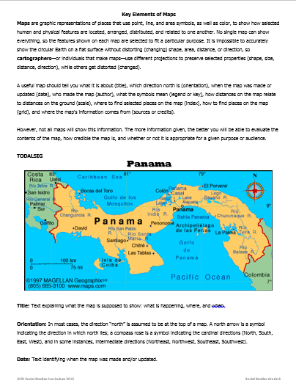
Direct Instruction – 15 minutes
Pre-reading activity:
Scan the text to get an idea of what we will read today. Be prepared to share out. Pay close attention to headings and bold words.

Slide 7
Checkpoint – 3 min
What are the key elements of a map?
How can each of these key points be used?
What have you learned about maps?

Slide 8
Guided Practice – 13 minutes
Reading Latitude and Longitude

Slide 9
Checkpoint – 3 min
What is the equator?
What is the prime meridian?
What key element of the map do you use to find absolute location?
Is knowing how to find absolute location important? Why or why not?
How is finding absolute location related to math?

Slide 10
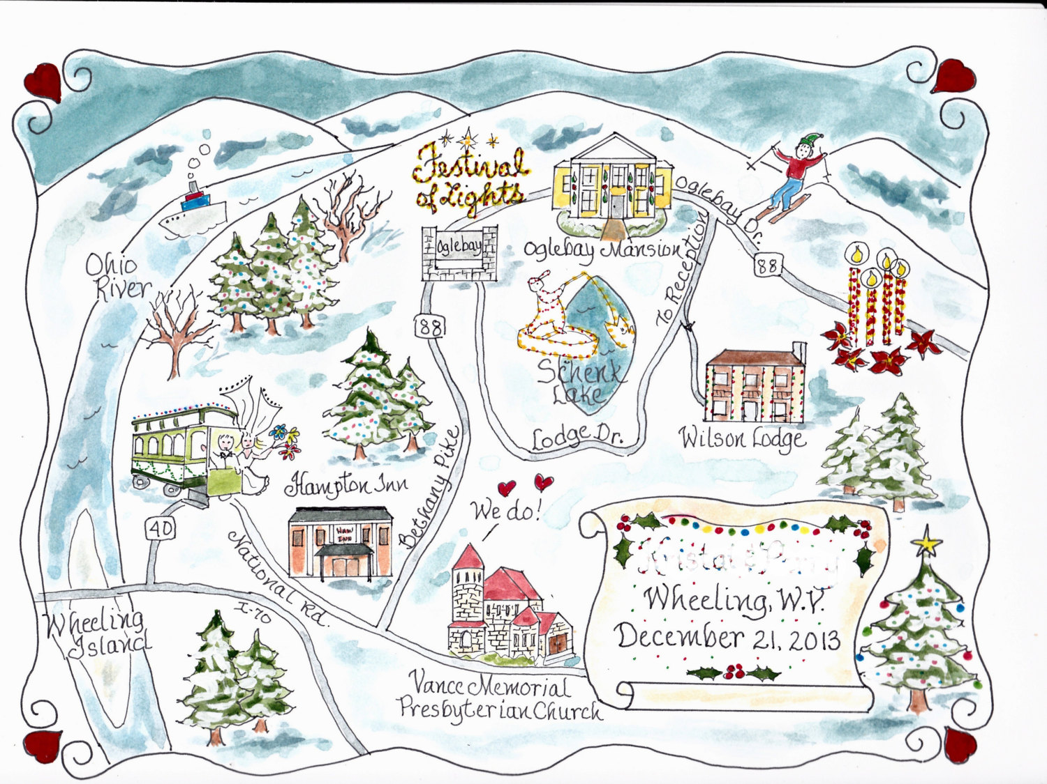
Team Work – 13 min
On your chart paper, you are going to create a map of the ideal city.
Your map must include all key elements.

Slide 11
Analyzing Maps – 5 min
Post your map around the room.
Using the Map Evaluation Sheet analyze 3 maps.
Draw this table in your notebook on page 2

Slide 12
Guiding Question Record your answer on page 2 of your notebook
What are the key elements of a map?
The key elements of a map are…
What strategy can you use to remember the elements of the map?
The strategy to remember key elements of a map is…
Which key elements are most important? The most important elements are… because…

Slide 13
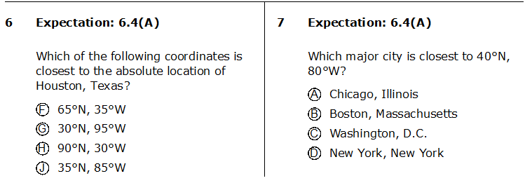
Exit Ticket Plickers!!! Use the handout of the map to answer the following questions.
1
2

